Slide 1
Baltimore Ravens: Jersey Popularity vs Twitter Followers
A case study by Molly ann williams

Slide 2
The Scenario
For this capstone project I am pretending to work for the Baltimore Ravens NFL team. The online store wants to run a promotion on jerseys this fall. They want to know which current players’ jerseys to feature and have asked me to determine who the most popular players are.

Slide 3
The Hypothesis
Strategy
Higher jersey sales = More Twitter followers
Which unit will be most popular?
Notes:
In order to determine the most popular current players, I devised a strategy to determine, through data, which jerseys sell the most on the online store site already, as well as how many followers each player has on Twitter.
It is my belief that, the players whose jerseys sell the most on the store site will concurrently have the highest number of Twitter followers.
I also posit that, when the results are divided by unit (Offense, Defense, and Special Teams), I will find that players from the Offense Unit will be the most popular in both jersey sales and on Twitter.

Slide 4
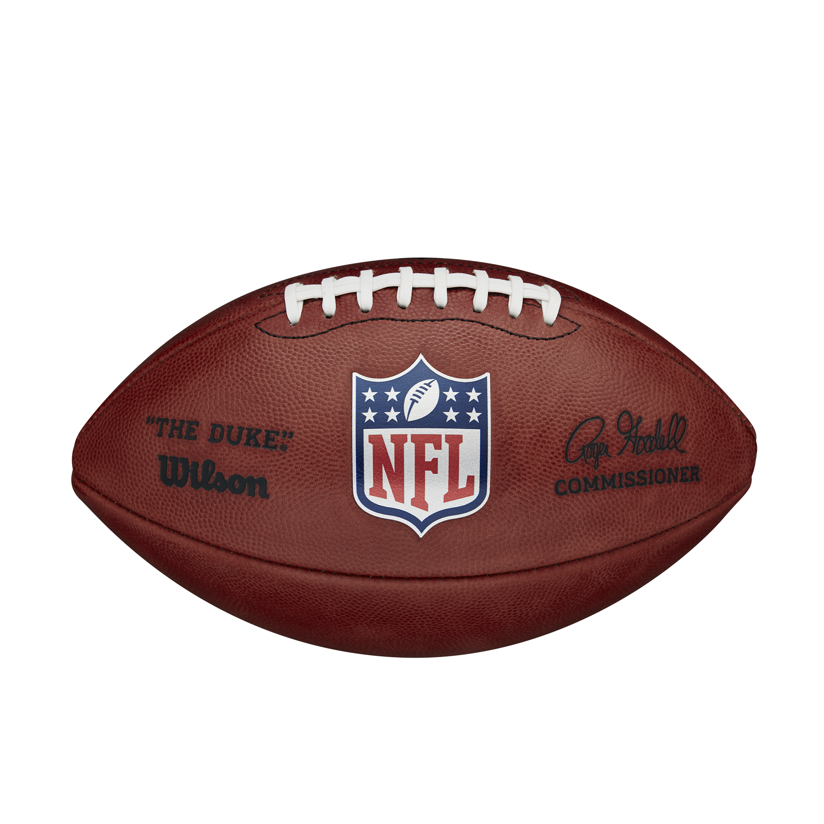
The Plan
Research
Compile
Organize
Analyze
Conclusions
Suggestions
Notes:
For my research, I searched the Internet for datasets about American Football. More specifically, I wanted to find data about player popularity. That would have saved me a lot of time. I also looked for data about overall jersey sales, but came up short. The best solution I came up with was to look at the players’ jerseys in the Baltimore Ravens’ website store, sort them by Top Sellers, and then record the top 20 most popular players. I assumed that the items were sorted in order of most sales per jersey.
Compile- Once I had this raw data I put it all together in spreadsheet format, using Excel. I extracted the current roster from the Ravens website and turned that into a sheet. Since I was not using any downloadable datasets, I took the time to create all the tables from scratch.
Organize- I filtered and sorted the data, and arranged it in a meaningful and efficient way. I used programs like BigQuery/SQL and Rstudio/R to sort and rearrange my data, and to create visualizations.
Analyze- I wrote down observations about the data, noted patterns I found in the charts, and made decisions based on these analyses.
Conclusions- I discovered that my original hypothesis about a correlation between jersey popularity and Twitter followers was mostly disproven. More on that later in the presentation.
Suggestions- At the end of the presentation I will put forward my suggestions for the stakeholders at the Ravens organization.

Slide 5

Problems
?

Slide 6
Problems with Data
No Twitter account?
Former players are very popular
Lamar is just too “Elite”
More than one jersey number?
Notes:
Once I searched for the top 20 most popular jerseys and sorted my roster list accordingly, I researched those players’ Twitter accounts. I found Morgan Moses (#78) does not have a Twitter account. Therefore I left him out of the project.
Determining the most popular player by ranking the jerseys for sale by “Top Sellers” on the website showed me current and former players mixed together. I skipped former players and went to the next most popular current player.
Quarterback Lamar Jackson (#8) was the most popular jersey sold, and had the most Twitter followers (approximately 1,000,000). The next highest amount of Twitter followers was kicker Justin Tucker (#9) who had a little more than 300,000. Plotting both variables on a graph would show a huge gap between the data points. I was concerned it would make the datapoints in the rest of the graph impossible to discern so I decided to cut him from the project as well.
In one case, I ran into a player who had jerseys for sale of both his current number and his former number. Rashod Bateman (#7, formerly #12) had jerseys with both numbers for sale. I chose to include his current number jersey only.

Slide 7
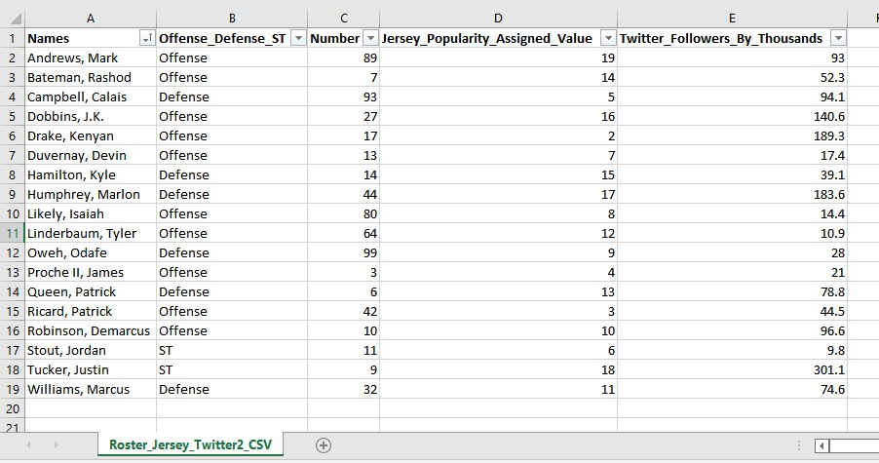
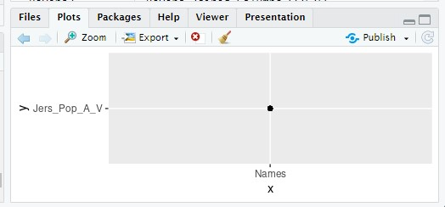
Early Tables and Charts – OOPS
A failed attempt at a plot in R.
One of the first charts I made with
the raw data.
Notes:
One major problem I ran into near the end of this project was that I lost almost all of my raw data. I had been saving each new spreadsheet meticulously, as a .CSV file, because I thought that would make it easier to upload into the different programming tools. Unfortunately I learned the hard way that saving it like that only preserves 1 sheet out of the whole document. I lost early charts, their base tables, and key observations that I had written in comments. I lost approximately 22 hours of work.
A second, and bigger issue, was the trouble I ran into with SQL and R. I thought I had a good grasp on each language but, when it came to doing anything but the basics, I had so many problems. Unfortunately, when I researched the problems online, the solutions involved code I had not even encountered yet, so I was unable to use the fixes. I will be taking separate courses in R and SQL as soon as this project is complete.

Slide 8
Analyze
By using SQL, R, and Excel, I was able to peer through the compiled data and whittle down all the information into a usable/chartable chunk of information.

Slide 9
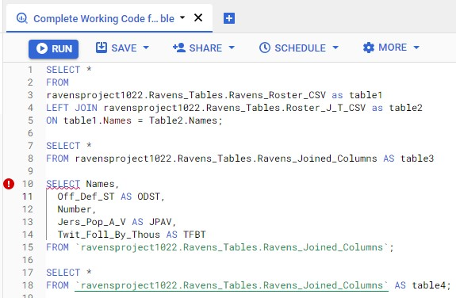
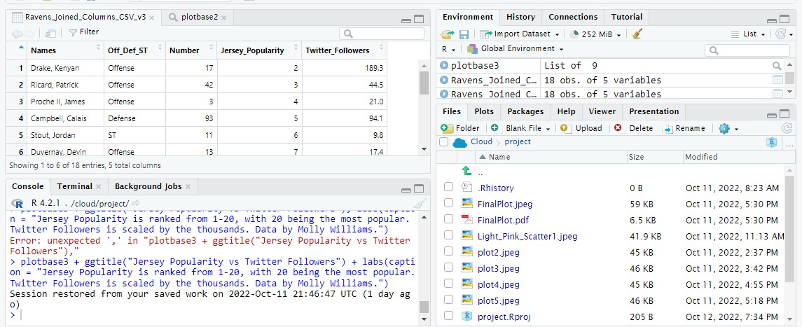
SQL Queries and R Code
Sample of My SQL Work
Sample of my R Code
Notes:
While I enjoyed learning and experimenting with SQL and R, I ran into many frustrations along the way. Error messages were more prevalent in my code than the code itself. I realized that I have a lot to learn with both languages, and my plan is to take additional classes after I finish this course.

Slide 10
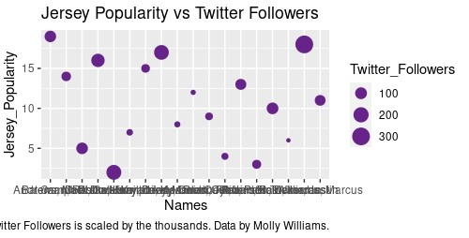
?
!
!
Failed Plot from BigQuery/SQL
Notes:
This was my best attempt at a plot using SQL. It’s not terrible, but as you can see, it’s not good either.

Slide 11
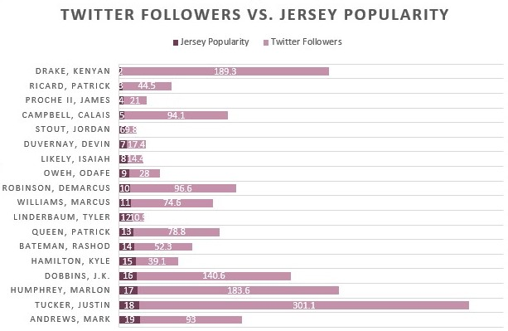
Conclusions: Was I Correct?
In a word, no.

Slide 12
Coming to the Wrong Conclusions
I found there was little to no correlation between jersey popularity and Twitter followers.
Notes:
*The numbers for jersey popularity are on a scale between 2-19 indicating the player's rank alongside the others. Because the numbers of their rank were so low, they wouldn't plot visibly on a chart with the Twitter followers numbers (which were in the thousands). I created a column displaying the rank number multiplied by 100. When plotted against the Twitter followers numbers (which were divided by 1,000 to bring them closer to the jersey popularity numbers) the basic pattern of popularity across both columns becomes visible.

Slide 13
Wrong and Right at the Same Time
Players from the Offense did have the most overall Twitter followers, when compared to the Defense and Special Teams.
Notes:
I was wrong about the jersey popularity correlating with the Twitter followers, but my other hypothesis was correct.

Slide 14
Suggestions
First five players
1st Lamar Jackson
2nd Justin Tucker
3rd Kenyan Drake
4th Marlon Humphrey
5th J.K. Dobbins
Promote the Offense
Notes:
I would tell my superiors that they should promote the top 5 most popular players, as determined by my research and analysis. I chose them based on a combination of their total number of Twitter followers combined with their rank in the jersey sales columns.
I would also suggest that they promote players from the Offense over any other unit, because those players have the most Twitter followers.

Slide 15
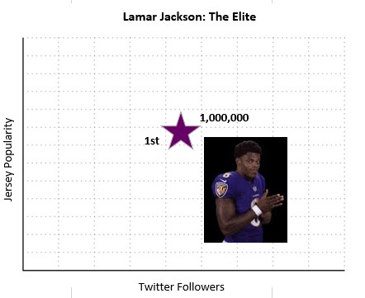
LaMarvelous
So Elite, he couldn’t be contained in a regular spreadsheet.
Notes:
Apologies for the inconsistent formatting of the “chart”, I created it days ago, saved it as a ..JPG and lost the raw data. Can you tell I’m a fan?

Slide 16
Thank you for your time.
Go ravens!

